Slide 1

Mentee
Slides

Slide 2
Settle in and get ready.
Notes:
Sophie start

Slide 3
Agenda
TIME
ACTIVITY
MATERIALS YOU’LL NEED
10 min | Introduction | Mentee Slides, Prompt
5 min | Video 1: How can I build my tech resilience? | Tech Resilience Video
10 min | Cohort introductions | Mentee Slides
20 min | Video 2: What are we talking about? | Active Listening Video
10 min | Ground rules & Wrap up | Post-survey

Slide 4
Introduction
We’re here to help you tap into and grow your tech resilience. As mentors, we’ll coach you through structured sessions with activities to encourage engagement and reflection.
5 min

Slide 5
Strategize Solutions
I reach out to find a sounding board to talk through my next steps.
I try to avoid difficult situations completely.
I try to visualize how others think about things.
I can troubleshoot problems with how I am thinking about a project.
I can step back and regroup when things go wrong.
I try to communicate clearly and transparently about how I am approaching the project.
I’ve been known to blow up at people because I’m so stressed.
I’ve been known to panic and get overwhelmed.
Team projects annoy me; I’d rather work alone.
I have strategies to make collaboration work for me.
Explore resilience prompts
For each situation, please decide if it sounds “more like” you or “less like” you. Please take a few minutes to do this.
More like
Less like
5 min

Slide 6
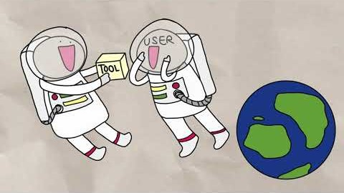
How can I build tech resilience? video
Evidence shows that resilience, the ability to recover quickly from challenges, is a strong indicator of a learner’s success in a given field.
You can tap into and further build your resilience to help you persist, whether learning computer science or navigating a career pathway in tech.
5 min

Slide 7
Cohort introductions
Take 1-2 minutes to share:
How would you like to be addressed? For example, what is your name and which pronouns do you use?
What is one reason why you signed up for this program?
10 min

Slide 8
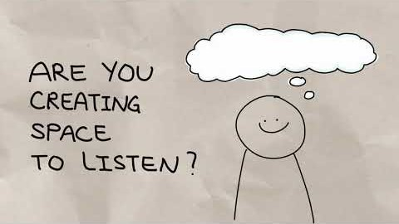

What are we talking about? video
Active listening is an important part of communication and refers to a process of listening to understand the speaker. You can signal you value and respect another person by listening with purpose.
By pausing to reflect and try on different perspectives, we could learn that while we intended to be helpful, our words might not have had the desired impact.
5 min

Slide 9
Let’s practice in pairs/trios!
8 min

Slide 10
Active Listening activity
Introduce yourselves (names, personal pronouns).
Take turns practicing speaking (2 minutes) and reflecting back (< 1 minute).
Choose something to share about
Your current CS class experience
Your plans for the future
Something that resonated from the video

Slide 11
Active Listening
cohort discussion
Listen with purpose:
Create space
Mirror to clarify
Try on perspective
Intent vs. impact: A well-intended message can still come across otherwise.
7 min

Slide 12
Ground Rules
Be open-minded.
Speak from your own perspective.
Facilitation means interruption & allowing for silence.
Be patient & create space for all to learn.
Assume good intention; recognize intent vs. impact.
What’s said here stays here; what’s learned can be shared.
Our role: mentors and facilitators not tutors
5 min

Slide 13
Recognize Discomfort
What can you apply from today to your life?
Wrap up
Share general
reactions, thoughts,
questions, ideas.
5 min

Slide 14
Recognize Discomfort
Please take this survey by yourself. This isn’t a test! Please do take this and be honest.
Survey
https://forms.office.com/Pages/ResponsePage.aspx?id=v4j5cvGGr0GRqy180BHbRyVMVauYU4FKq-OM6yM4JUZUN1FKTUdFMTVWWlJSN0lMUVpXVUFKMTBOWC4u
5 min

Slide 15
Recognize Discomfort
to engage, not avoid

Slide 17
self-efficacy & mindset
belongingness self-regulation &

Slide 18
Agenda
Recognize Discomfort
TIME
ACTIVITY
MATERIALS YOU’LL NEED
15 min | Introduction | Mentee Slides, Prompt
20 min | Video 1: Can I do it? | Self-efficacy Video
40 min | Collab Exercise: Can I hack it? (Parts 1 and 2) | Mentee Slides, Activity
20 min | Video 2: Is it possible? | Mindset Video
20 min | Wrap up and discussion | Mentee Slides

Slide 19
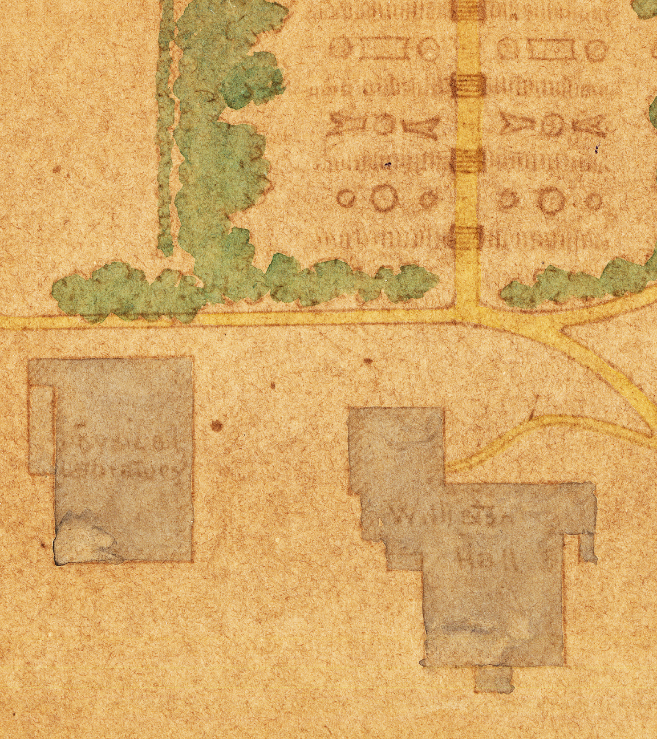
Recognize Discomfort
Introduction: Can I hack it?
“I’ve mapped the site, but need to create a detailed blueprint of each building. If I sketch the walls for a building, can you tell me where place LiDAR scanners? Time is of the essence, so make sure you’re optimizing their placement!”
5 min

Slide 20
A. Help the archaeologist with the map challenge.
Recognize Discomfort
Work on the map challenge with someone you just met.
Find bugs in a short piece of code.
Speak up if a social dynamic is not working for me.
Create a website.
Answer a question in class.
Form a group in class.
Raise my hand if I’m confused.
Introduce myself to a new group.
Request help from an instructor.
Pitch my idea at a hackathon.
Write an email to my advisor.
Make an appointment for office hours.
Explore discomfort prompts
For each situation, please decide if it is “in your comfort zone,” “outside of your comfort zone,” or if you “feel neutral.” Please take a few minutes to do this.
In comfort zone
Out of comfort zone
Neutral
5 min

Slide 21
Recognize Discomfort
Explore discomfort cohort discussion
What was interesting or surprising to you about the prompts?
Did you find yourself thinking, “This is so me!” or “That’s right up my alley!”
Were there some situations where you thought, “I can’t do that” or “That’s not me”?
5 min

Slide 22
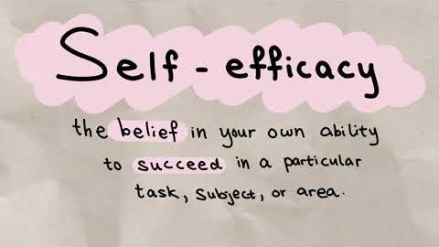
Recognize Discomfort
Can I do it? video
Self-efficacy is the belief in your ability to succeed in achieving a specific goal or task. The higher your self-efficacy is, the more you believe you are capable of accomplishing the task.
After the video, you’ll have a chance to talk with a peer to reflect on connections to your own experiences.
As you watch, what resonates with you?
5 min

Slide 23
Let’s discuss in pairs/trios!
Recognize Discomfort
8 min

Slide 24
You can increase self-efficacy by noticing small successes. Can you imagine building upon them?
Recognize Discomfort
Self-efficacy
cohort discussion
Self-efficacy can be impacted by comparing yourself to other people. Are you making a fair social comparison?
Feedback can help you to grow your confidence to achieve certain tasks. Can you unpack feedback constructively?
7 min

Slide 25
Collab Exercise Can I hack it?
Recognize Discomfort
40 min

Slide 26
Collab Exercise the ask
Recognize Discomfort
“I’ve mapped the site but need to create a detailed blueprint of each building. If I sketch the walls for a building, can you tell me where place LiDAR scanners? Time is of the essence, so make sure you’re optimizing their placement!” – archeologist
Are you in your comfort zone?
Out of your comfort zone?
Feeling neutral?
2 min

Slide 27
Collab Exercise dig in
Recognize Discomfort
“I’ve mapped the site, but need to create a detailed blueprint of each building. If I sketch the walls for a building, can you tell me where place LiDAR scanners? Time is of the essence, so make sure you’re optimizing their placement!”
Can you name what’s uncomfortable?
Are there words or phrases that stick out?
2 min

Slide 28
Collab Exercise engage
Recognize Discomfort
“I’ve mapped the site, but need to create a detailed blueprint of each building. If I sketch the walls for a building, can you tell me where place LiDAR scanners? Time is of the essence, so make sure you’re optimizing their placement!”
Can you take a closer look at the sources of discomfort?
What about asking a peer or someone more experienced for help?
Note: A “LiDAR scanner” is a specific type of hardware that scans to get distance data. In this case, assume the scanner can obtain 360 degrees of data, much like a floodlight.
3 min

Slide 29
Collab Exercise clarify
Recognize Discomfort
“I’ve mapped the site, but need to create a detailed blueprint of each building. If I sketch the walls for a building, can you tell me where place LiDAR scanners? Time is of the essence, so make sure you’re optimizing their placement!”
How can you make the problem precise?
How is the input described?
Try an example!
This is one example sketch of the walls for a building.
Can you make a sketch of your favorite building?
3 min

Slide 30
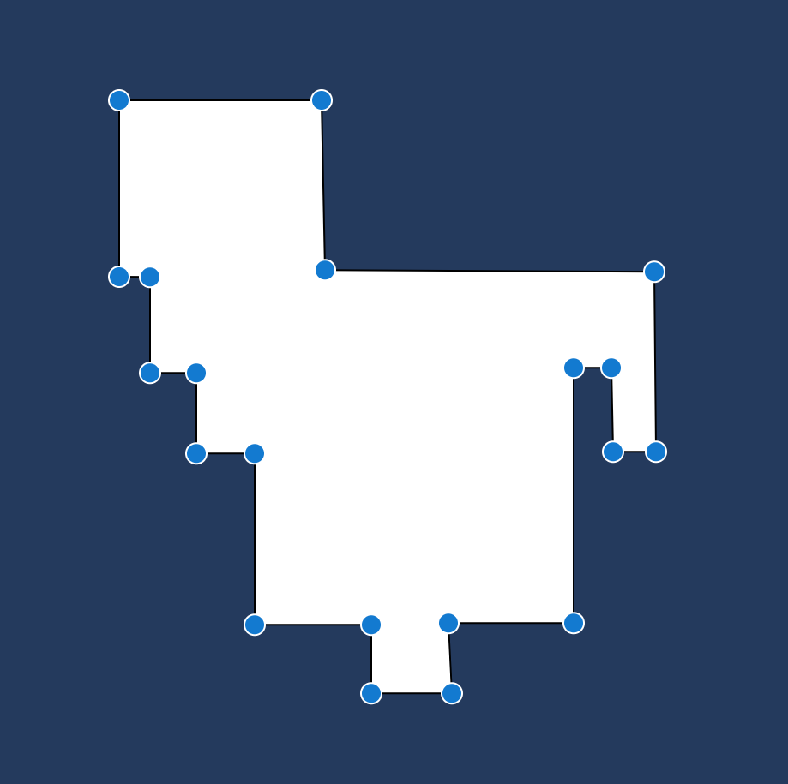
Collab Exercise be precise
Recognize Discomfort
“I’ve mapped the site, but need to create a detailed blueprint of each building. If I sketch the walls for a building, can you tell me where place LiDAR scanners? Time is of the essence, so make sure you’re optimizing their placement!”
How can you make the problem precise?
How is the input described?
Try an example!
A simple polygon is composed of non-intersecting straight line segments that close off an interior region.
2 min

Slide 31
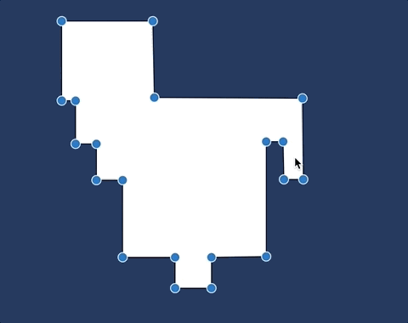
Collab Exercise formulate
Recognize Discomfort
“I’ve mapped the site, but need to create a detailed blueprint of each building. If I sketch the walls for a building, can you tell me where place LiDAR scanners? Time is of the essence, so make sure you’re optimizing their placement!”
What is the problem asking?
What is the expected output?
Try an example!
Think of a scanner as a floodlight. Then the task is to place scanners to light the interior region.
We should be optimizing their placement to use the fewest number of scanners.
3 min

Slide 32
Collab Exercise Spot the Difference
Recognize Discomfort
Work with your partner(s) to spot 7 differences. Take a minute to discuss how you wish to collaborate. This exercise is not just about finding the answer.
You do not need to know either language to complete the activity! In fact, it may be easier if you don’t know the language.
15 min

Slide 33
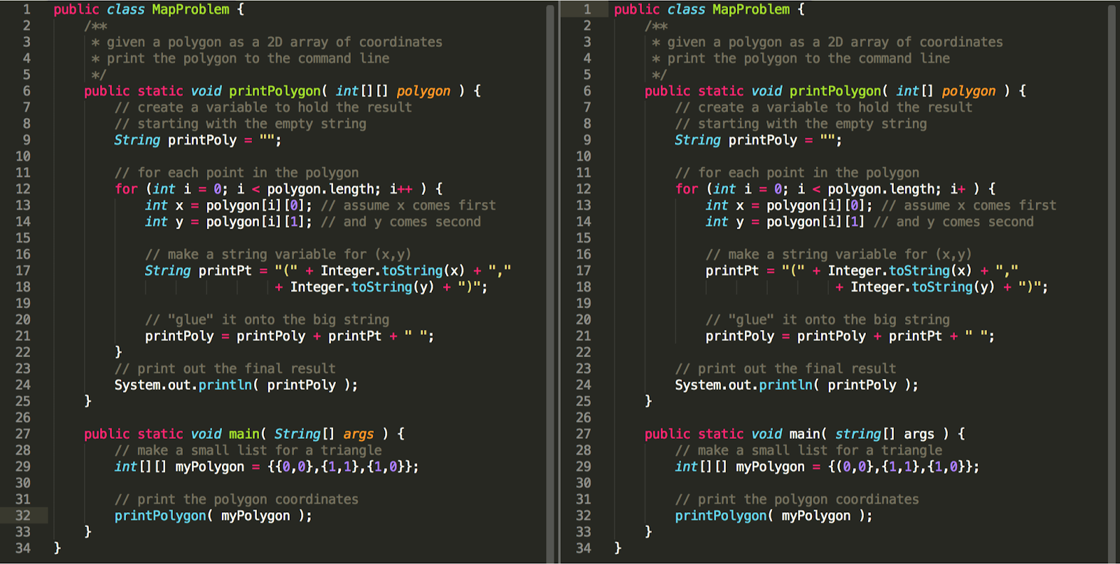
Recognize Discomfort
Is it possible? video
Research has proven that having a growth mindset toward learning computer science can improve resilience and a students’ ability to succeed.
In a growth mindset we show a passion for learning and not a hunger for approval. With growth mindset people don’t actually see themselves as failing— they see themselves as learning.
Spot the differences java

Slide 34
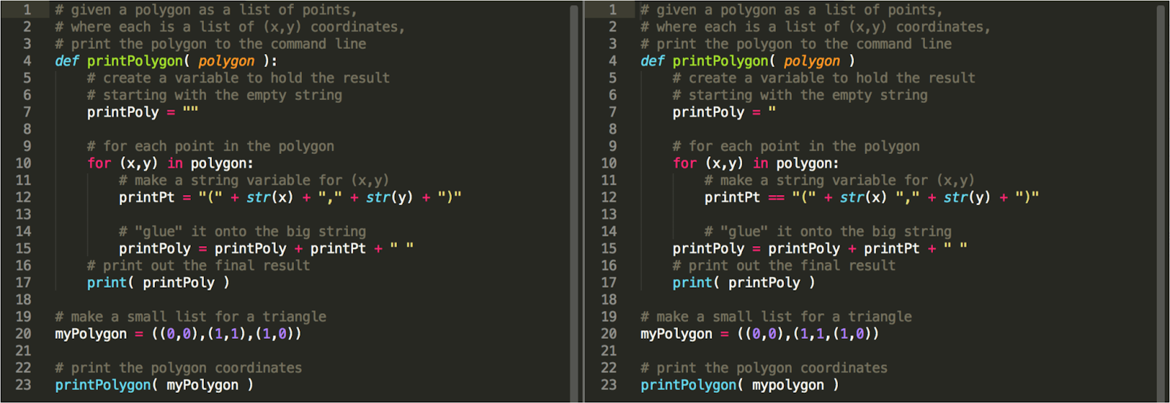
Recognize Discomfort
Spot the differences python

Slide 35
Collab Exercise cohort discussion
Recognize Discomfort
WHAT WAS IT LIKE FOR YOU TO…
Dig into a word problem
Look for bugs in code
Collaborate with partner(s)
Stop and think about this: no one is born able to spot missing colons and mismatched curly braces.
But, have you ever heard that certain people are “born programmers”?
8 min

Slide 36
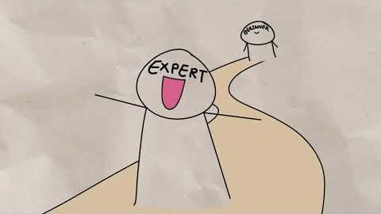
Recognize Discomfort
Is it possible? video
Research has demonstrated that having a growth mindset toward learning can improve resilience and a students’ ability to succeed. A growth mindset is reflected through a passion for learning, not a hunger for approval; people don’t see themselves as failing, but as learning.
After the video, you’ll have a chance to share with the group a reflection on how it relates to your own experiences.
As you watch, what resonates with you?
5 min

Slide 37
Mindset
cohort discussion
Recognize Discomfort
In which areas of your life do you think you have a growth mindset? A fixed mindset?
Are there areas where you shifted from a fixed mindset to a growth mindset? What prompted the change?
15 min

Slide 38
Recognize Discomfort
“I can’t do
,”
Wrap up
“I’m not a person,” “I could never achieve
How we view ourselves and our abilities can have a profound impact on our progress and success.
Check in on your self-talk.
.”
“I can’t do
yet,”
“I can be successful at new things.” “With time and effort, I can improve in .”
5 min

Slide 39
A. Crafting a resume
Recognize Discomfort
Onboarding to a new team or supervisor
Asking a question of your instructor or TA
Asking a peer to connect on homework after class
Signing up for a hackathon
Pitching an idea to a group
Trying something new for the first time
Learning about a topic that feels intimidating
Taking a class that seems like everyone was born with CS knowledge
Further Exploration
Pick 2-3 scenarios that are most out of your comfort zone you can choose from this slide or from something we’ve covered today.
We’ll discuss how the skills learned today can apply.
In comfort zone
Out of comfort zone
Neutral
5 min
Optional

Slide 40
What can you apply from today to your life?
Recognize Discomfort
Open Discussion
Share general
reactions, thoughts,
questions, ideas.
10 min

Slide 41
Recognize Discomfort
Welcome!
Settle in and get ready.

Slide 42
self-efficacy & mindset
belongingness
self-regulation &
emotional intelligence

Slide 43
Agenda
Recognize Discomfort
TIME
ACTIVITY
MATERIALS YOU’LL NEED
15 min | Introduction | Mentee Slides, Prompt
20 min | Video 1: Is this for me? (Part 1) | Belonging Video Part 1
25 min | Collab Exercise: How do I find my way? | Mentee Slides, Activity
20 min | Video 2: Is this for me? (Part 2) | Belonging Video Part 2
30 min | Wrap up and discussion | Post-survey

Slide 44

Recognize Discomfort
Introduction: How do I find my way?
When we encounter new technology, two factors can show up in our self-talk: self-efficacy (“can I do it?”) and mindset (“am I this kind of person?”). Sometimes these lead to the question: “do I belong in tech?”
5 min
Notes:
Amanda

Slide 45
A. Get overwhelmed and procrastinate choosing a tech tool.
Recognize Discomfort
Explore belonging prompts
For each situation, please decide if it sounds like you “frequently,” “occasionally” or “never.” Please take a few minutes to do this.
Ask a trusted source with expertise for tech help.
Wonder if becoming a “tech person” is for me.
Post a question on a tech forum.
Post a response on a tech forum.
Get excited to try out a bunch of new tech tools.
Walk into a classroom and feel I can choose any seat.
Avoid raising my hand so I look like I know what I’m doing.
Wonder if I can connect with other tech people.
Write a blog post/tutorial to teach others new tech.
Think of myself as a tech “newbie.”
Offer to help the person next to me when I see they are struggling.
Frequently
Occasionally
Never
5 min
Notes:
Amanda

Slide 46
Recognize Discomfort
Explore belonging cohort discussion
What was interesting or surprising to you about the prompts?
Did you find yourself wondering about how your peers might respond?
Were there some prompts where you would have answered very differently before starting your first CS course?
5 min
Notes:
Amanda

Slide 47
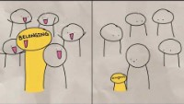
Recognize Discomfort
Is this for me? (part 1) video
Fitting in is different than belonging. “Fitting in is about assessing a situation and becoming who you need to be to be accepted. Belonging, on the other hand, doesn’t require us to change who we are; it requires us to be who we are.” —Brené Brown
After the video, you’ll have a chance to talk with a peer to reflect on connections to your own experiences.
As you watch, what resonates with you?
5 min

Slide 48
Let’s discuss in pairs/trios!
Recognize Discomfort
8 min
Notes:
Neeraja + breakout rooms

Slide 49
Self-efficacy can contribute to whether we feel we have a place or a sense of belonging in the field.
Recognize Discomfort
Belonging (part 1)
cohort discussion
Remember: you cannot know someone else’s prior experience offhand. Social comparisons can make us (unfairly) question our potential contributions.
Tech tools change and emerge constantly. Interactions with the supporting documentation and community can impact whether you stick with it or not.
7 min
Notes:
Neeraja

Slide 50
Collab Exercise How do I find my way?
Recognize Discomfort
25 min

Slide 51
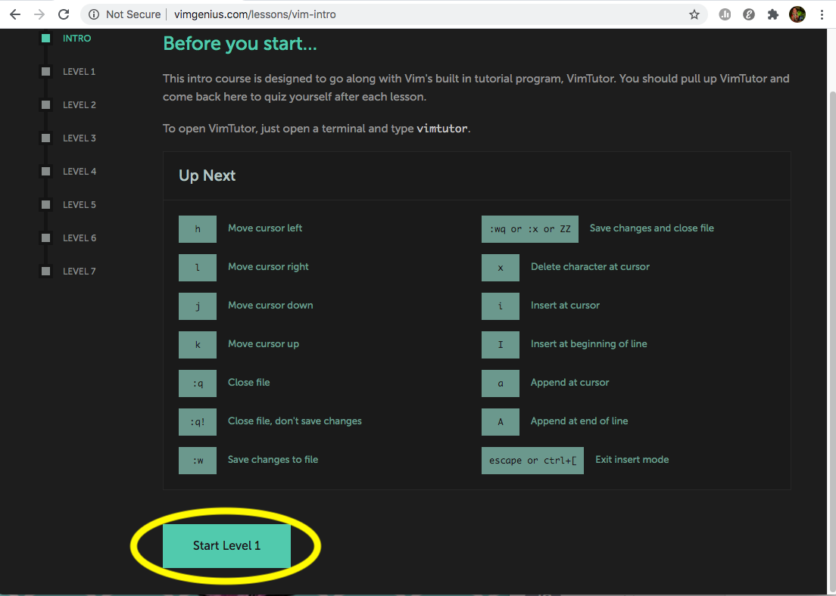
Collab Exercise vim activity
Recognize Discomfort
Open the “Vim Genius” site on your respective computers. You will not use screen share.
Pick one person to be the “expert” and the other(s) to be the “newbie(s).”
The ”newbie(s)” should use the button at the bottom to start Level 1.
The “expert” should keep the initial screen with commands open to provide help.
For about 4 minutes, the “newbie(s)” should go proceed through the level(s), asking for help from the “expert” as needed.
Switch roles and repeat!
http://www.vimgenius.com/lessons/vim-intro
15 min

Slide 52
Collab Exercise cohort discussion
Recognize Discomfort
WHAT WAS IT LIKE FOR YOU TO…
Try out vim commands
Ask for help
Provide help
Through a show of hands, did you find yourself saying: “This is right up my alley.” or “This is SO me!” or “I’m not this kind of person.” or “I don’t think this is for me.”
Did you find yourself connecting over how unintuitive the Vim commands are?
Does this activity make you think of other times where you struggled to learn a new tech tool?
10 min

Slide 53
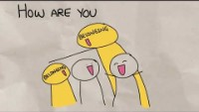
Recognize Discomfort
Is this for me? (part 2) video
Belonging is not always about whether you believe you can do something. It is also about whether you see yourself as a “tech person.“ This component of belonging is related to mindset: the static idea of a “tech person” can indicate a fixed mindset about who is in tech.
After the video, you’ll have a chance to share with the group a reflection on how it relates to your own experiences.
As you watch, what resonates with you?
5 min

Slide 54
Belonging (part 2) cohort discussion
Recognize Discomfort
Can you think of a time when you made an assumption about your ability to succeed because you did (not) think of yourself as a “tech person”?
What about a time when you made an assumption about someone else?
Have you ever received help in a way that made you feel like you did not belong?
Have you ever gone out of your way to invite someone’s participation and help them to feel more comfortable?
10 min

Slide 55
Recognize Discomfort
“Do I fit in?,”
Wrap up
“When do I get to call myself a developer?,” “Tech isn’t for everyone.”
Having a community that invites you in and provides support can make a big difference in whether you decide to persist.
Check in on your self-talk, using the righthand side of this page as a starting point.
“Why do I feel like I (don’t) belong?,”
“Look at how far I’ve come!,”
“How can I invite a newbie in?”
5 min

Slide 56
A. Deciding which companies to approach for a role
Recognize Discomfort
Preparing for a conversation with an industry professional
Finding a study group or project team
Answering a question in class
Applying to be a TA in your department
Voicing your concerns on a group project
Raising your hand to take the lead on a project
Feeling like you need to be a certain way to fit into your CS peer group
Wondering “Do I belong” in class as a response to a peer comment
Changing jobs
Further Exploration
Pick 2-3 scenarios that are most out of your comfort zone. You can choose from this slide, from the belonging prompts showed earlier today, or from your personal experience.
We’ll discuss how the skills learned today can apply.
In comfort zone
Out of comfort zone
Neutral
5 min
Optional

Slide 57
What can you apply from today to your life?
Recognize Discomfort
Open Discussion
Share general
reactions, thoughts,
questions, ideas.
20 min

Slide 58
Strategize Solutions
to tackle challenges

Slide 59
Strategize Solutions
Welcome!
Settle in and get ready.

Slide 60
belongingness self-regulation &
emotional intelligence
cognitive flexibility & effective feedback

Slide 61
Agenda
Strategize Solutions
TIME
ACTIVITY
MATERIALS YOU’LL NEED
15 min | Introduction | Mentee Slides, Prompt
20 min | Video 1: How can I do this strategically? | Self-regulation Video
40 min | Collab Exercise: Am I up to the challenge? | Mentee Slides, Activity
20 min | Video 2: What can I do to get through this? | Emotional Intelligence Video
20 min | Wrap up and discussion | Post-survey

Slide 62
Introduction: Am I up to the challenge?
Remember… an archaeologist asked you for help! Given a building outline, place scanners that cover the interior. This is known as the “Art Gallery” problem: where do you place “guards” in a simple polygon so that all walls are protected?
5 min

Slide 63
Strategize Solutions
I like to create a game plan before jumping into a complex project.
I tend to engage in haphazard guesswork rather than systematically try approaches and write down their outcomes.
I can step back and troubleshoot how I am thinking about a project.
I can spend hours on something, come up empty handed, and not know how I spent the time.
I ask other people to observe me and reflect back what they see me doing/not doing.
I spend more time rehashing what happened in a feedback session rather than moving ahead on revising my work.
I find it hard to keep my motivation when I hit a setback.
I spend a lot of energy worrying about deadlines.
Explore challenge
prompts
Read each statement and decide if it is something “more like” or “less like” you. Then, record the letter in the column of your answer.
More like
Less like
5 min

Slide 64
Explore challenge cohort discussion
What was interesting or surprising to you about the prompts?
Did you find yourself analyzing your process for approaching a problem?
Do you come up with a plan before you start programming?
5 min

Slide 65
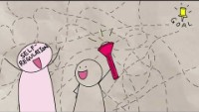
Strategize Solutions
How can I do this strategically? video
One thing that can help us to push through a challenging project is the ability to step outside of our own thinking and strategize about whether we have a good plan. That capacity to create a plan, try it out, see how it works before regrouping and try again is called self-regulated learning.
After the video, you’ll have a chance to share with the group a reflection on how it relates to your own experiences.
As you watch, what resonates with you?
5 min
Notes:
https://www.youtube.com/watch?v=mX6cQKFelf0&list=PL6ihFEvicZRCOEbfvjkWPculxOhSsNwt2&index=7

Slide 66
Let’s discuss in pairs/trios!
Strategize Solutions
8 min

Slide 67
Self-regulation cohort discussion
Strategize Solutions
The ability to step outside of our own thinking and strategize about whether we have a good plan can help us tackle a challenge.
The capacity to step back and study our own thought process is called metacognition. It is the first step in an iterative process called the self-regulated learning feedback loop.
Can you think of a recent time you used the strategic feedback loop or you wish you had?
How might your responses to the prompts you reflected on at the beginning of this session be altered by applying self-regulation?
7 min

Slide 68
Collab Exercise Am I up to the challenge?
Strategize Solutions
40 min

Slide 69
Collab Exercise the ask
The “Art Gallery Problem”: Given a simple polygon, place the fewest number of guards to cover the interior.
Are you up for the challenge?
How can you use the self-regulated learning feedback loop when tackling this problem?
We need to: plan, do, evaluate!
A simple polygon is composed of non-intersecting straight line segments that close off an interior region.
We should be optimizing their placement to use the fewest number of guards.
4 min

Slide 70
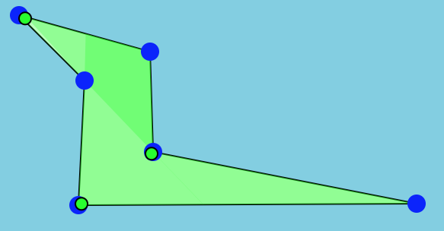
Collab Exercise “alternating” plan
Given a simple polygon, place a guard on alternating points.
How many guards for a polygon with n points?
It helps to see an example.
It works on this example!
2 min

Slide 71
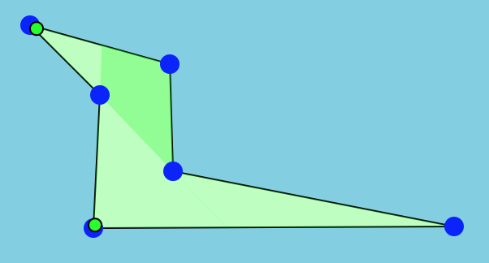
Collab Exercise “top and bottom” plan
Given a simple polygon, place a guard on the highest point and a guard on the lowest point.
How many guards for a polygon with n points?
It helps to see an example.
It works on this example!
2 min

Slide 72
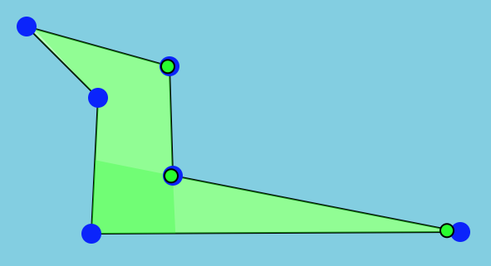
Collab Exercise “random half” plan
Given a simple polygon, pick a random starting point, then place guards on until you’ve covered half the points.
How many guards for a polygon with n points?
It helps to see an example.
It works on this example!
2 min

Slide 73
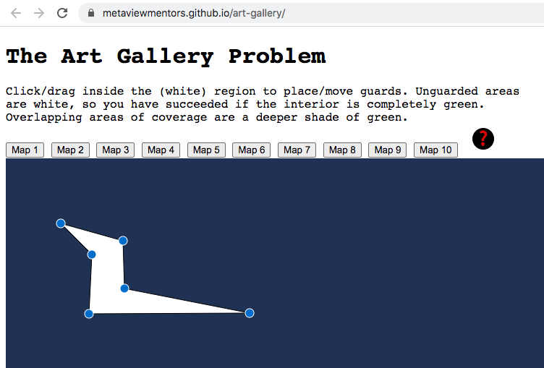
Collab Exercise activity
In your group, you’ll practice parts of the self-regulated learning cycle on the Art Gallery Problem.
PLAN phase: come up with a plan. Choose one of the three ways to approach the problem of placing guards at points along the polygon: “alternating” or “top and bottom” or “random half.”
DO/EVALUATE phases: try it & see if it worked.
Choose one person to screen share the web site.
Try out the plan on each map from 1 – 10 or make a new one.
Evaluate how well the plan works for each. Record your findings.
15 min

Slide 74
Recognize Discomfort
Collab Exercise cohort discussion
WHAT WAS IT LIKE FOR YOU TO…
Pick a prescribed plan
Try and evaluate the plan
Collaborate with partner(s)
When you find yourself using haphazard guesswork, realize you may be wasting time by not systematically recording what you did.
Pause to strategically make a plan and use a log to record and probe what is working.
Examine your state to intentionally direct your thoughts; you can regulate them and come up with different ways of revising your plan.
10 min

Slide 75
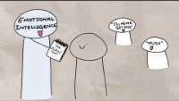
Strategize Solutions
What can I do to get through this? video
Emotional intelligence (EQ) is defined as the ability to identify, name and manage your emotions. Exercising your emotional intelligence can help you improve your interactions with others. EQ isn’t typically taught in a CS curriculum, but is essential for the workplace.
After the video, you’ll have a chance to share with the group a reflection on how it relates to your own experiences.
As you watch, what resonates with you?
5 min

Slide 76
Emotional intelligence cohort discussion
Strategize Solutions
Self-regulation can help our EQ: we can create a plan for how we might manage our emotions and learn from what we try.
Can you think of a situation where using emotional intelligence could benefit you?
Exercising our EQ makes us stronger collaborators. We can read and react to social cues indicating a teammate’s emotional state and manage our own frustration or confusion.
Can you think of an interaction with another person where you or your collaborator could have benefitted from practicing or growing your EQ?
15 min

Slide 77
Strategize Solutions
Self-regulated learning
Plan your approach
Try it out
Evaluate
Wrap up
To tackle a challenge, take the time to think about HOW you are approaching the problem-solving process. Using an iterative strategy can help you regulate your effort and keep you on course.
This same strategy can also help you when emotions are at play: you can pause, recognize and regulate to stay on course when solving problems independently or collaboratively.
Emotional intelligence
Pause for awareness
Plan your response
Practice perspective-taking
5 min

Slide 78
Strategize Solutions
Talking through your approach to solving a problem during an internship interview
Strategically asking questions that highlight your skills and interest in an interview
Recognizing that your emotions could impact your ability to focus on a tough question from a TA, instructor, or supervisor
Feeling stuck on homework
Negotiating a project’s next step when a team member is frustrating you
Getting a poor mark on an exam or project
At a hackathon, working against a deadline, navigating communication
Learning a new language or platform
Further Exploration
Pick 2-3 scenarios that are most out of your comfort zone. You can choose from this slide, from the prompts showed earlier today, or from your personal experience.
We’ll discuss how the skills learned today can apply.
Optional

Slide 79
Strategize Solutions
What can you apply from today to your life?
Open Discussion
Share general
reactions, thoughts,
questions, ideas.
10 min

Slide 80
Pivot & Persist
to expand perspective

Slide 82
self-regulation &
emotional intelligence
cognitive flexibility &
effective feedback

Slide 83
Agenda
Pivot & Persist
TIME
ACTIVITY
MATERIALS YOU’LL NEED
15 min | Introduction | Mentee Slides, Prompt
20 min | Video 1: Where do I go from here? | Cognitive Flexibility Video
40 min | Collab Exercise: Can I pivot? | Mentee Slides, Activity
20 min | Video 2: Where did that come from? | Effective Feedback Video
20 min | Wrap up and discussion | Post-survey

Slide 84
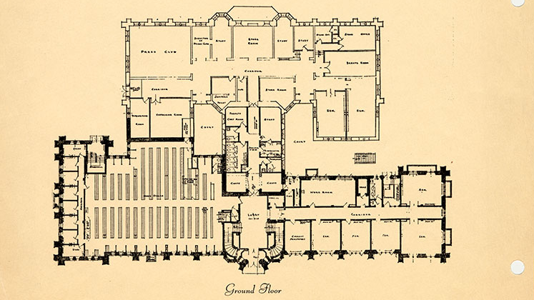
Introduction: Can I pivot?
Just when you were getting used to simple polygons…now there are obstacles in the gallery! Interior walls, bookcases and more will block the guards’ view. Are you ready to adapt? Where do you go from here?
5 min

Slide 85
A. I can find it difficult to abandon an approach even when it is clearly not working for me.
Pivot & Persist
Explore pivoting prompts
If the door closes, I am the person who finds a window.
I step back to pull out the useful information from negative feedback so I can move forward.
I am likely to give up if an expert tells me I'm not cut out for an area.
I am open to change.
I like to try on new perspectives.
I have a set list of things I know how to do, and I cannot do anything new.
I say "help me!" to someone else without specifying how the person can help.
I spend more time rehashing an exchange with difficult feedback rather than revising my work.
Read each statement and decide if it is something “more like” or “less like” you. Then, record the letter in the column of your answer.
More like
Less like
5 min

Slide 86
Explore pivoting cohort discussion
Pivot & Persist
Even the best laid plans can hit a roadblock. When an unexpected setback occurs, what do you do?
How open are you to stretching beyond your comfort zone?
Do you seek feedback from others? Do you have a strategy for unpacking the feedback?
5 min

Slide 87
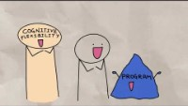
Pivot & Persist
Where do I go from here? video
The ability to pivot and change is called cognitive flexibility. Cognitive flexibility goes beyond pivoting about plans. It’s also about stretching our imagination to see ourselves and others in our environments in new ways.
After the video, you’ll have a chance to talk with a peer to reflect on connections to your own experiences.
As you watch, what resonates with you?
5 min

Slide 88
Let’s discuss in pairs/trios!
8 min

Slide 89
Cognitive flexibility cohort discussion
Pivot & Persist
Creating a plan requires a great deal of mental energy, focus, and direction. Yet we also need to be able to step away from a plan that no longer serves us.
Can you think of a time where you had to give up on a plan and wished you’d let go of it sooner?
Viewing a problem from different perspectives can help generate multiple paths forward or identify a bug in your approach. In fact, this is exactly what a ”debugger” enables you to do with your code: set a breakpoint to pause and step back/over/into your program’s execution.
Can you think of other situations where a different vantage point has moved you past an obstacle?
7 min

Slide 90
Collab Exercise Can I pivot?
40 min

Slide 91
Collab Exercise the ask
Recall the “Art Gallery Problem”: Given a simple polygon, place the fewest number of guards to cover the interior.
Are you ready to pivot?
Can you stretch your cognitive flexibility?
Now there are obstacles in the gallery! Interior walls, bookcases and more will block the guards’ view.
What else could be thrown your way?
5 min

Slide 92
Collab Exercise the pivot
Each group will get:
A pivot prompt
5 minutes to “own” the room: brainstorm how to adapt
Everyone else will turn off video and mute audio
When it is not your group’s turn, stretch your cognitive flexibility by listening in for different perspectives. Jot down thoughts and ideas, but please do not use the chat.
You’ll be working in pairs/trios, but… this time we will stay together!
Remember:
It’s about your approach and stretching cognitive flexibility, not about finding the “right” solution.
Practice active listening.
Move from “It is” or “It must be” to “Could it be..?” “Might it be…?”
Articulate your approach.
Explicitly name what’s difficult (maybe the activity itself)
5 min

Slide 93
Collab Exercise pivot prompt 1
Can you pivot?
Remember:
Be open
Try different perspectives
Generate multiple solutions
Now there are obstacles in the gallery! Interior walls, bookcases and more will block the guards’ view.
How will you decide where to place guards?
5 min

Slide 94
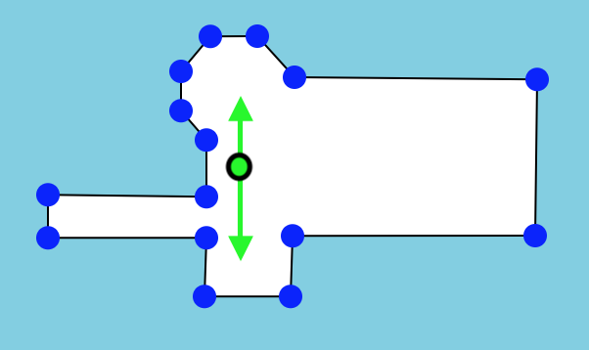
Collab Exercise pivot prompt 2
Can you pivot?
Remember:
Be open
Try different perspectives
Generate multiple solutions
The obstacles are gone, but now you have robots that can move and capture 360 degrees of video data.
How will you decide where to deploy the robots?
5 min

Slide 95
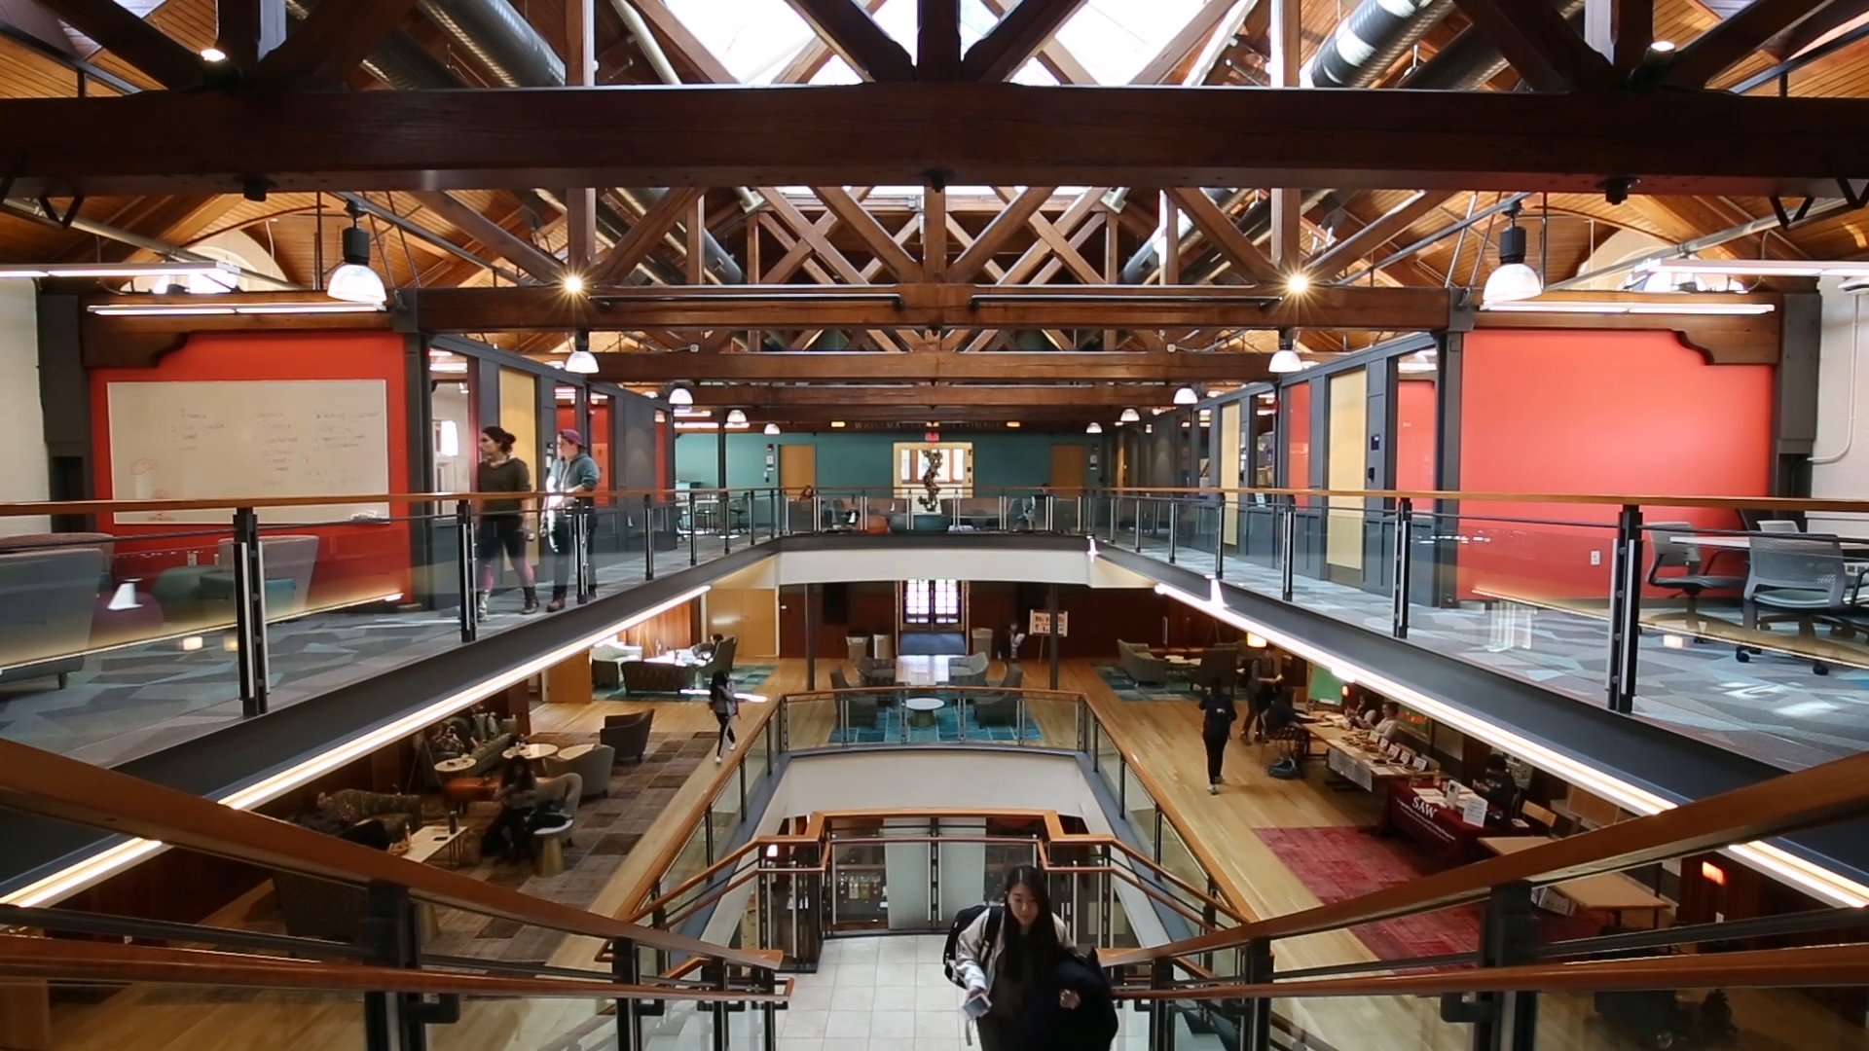
Collab Exercise pivot prompt 3
Can you pivot?
Remember:
Be open
Try different perspectives
Generate multiple solutions
No more robots, but now the space is fully 3-dimensional and has obstacles.
How will you decide where to place the guards?
5 min

Slide 96
Collab Exercise cohort discussion
WHAT WAS IT LIKE FOR YOU TO…
Adapt to a new setting
Brainstorm with partner(s)
Listen in on other groups
How often do you reflect on your problem solving approach and not problem itself?
How does cognitive flexibility connect with topics we’ve discussed in prior sessions?
Articulating your thought process can help clarify where you’re stuck or brainstorm new ideas; you can benefit greatly by collaborating with others.
15 min

Slide 97
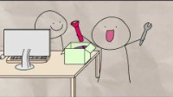
Pivot & Persist
Where did that come from? video
Feedback can vary widely in its content and delivery. Sometimes it’s hard to extract how to improve. Perhaps we’re only told that we went down the wrong path, and we have to continue the conversation to clarify and identify next steps.
After the video, you’ll have a chance to share with the group a reflection on how it relates to your own experiences.
As you watch, what resonates with you?
5 min

Slide 98
Effective feedback cohort discussion
Pivot & Persist
Feedback from others can help us move through the self-regulated feedback cycle, if we can receive it effectively.
While there might be feedback that we have to leave on the table, those who are in a position to give us feedback (an instructor, peer, or supervisor) usually have something constructive to offer.
How do we not let the fear of receiving feedback or the sting of difficult feedback keep us from improving our work?
What strategies can you use to unpack feedback to gain more information about which parts of our plan are strong and which could benefit from revision?
15 min

Slide 99
Strategize Solutions
Cognitive flexibility
Be open
Try on different perspectives
Generate multiple solutions
Wrap up
The next time you feel the rug is pulled out from under you, remember that you have options. You can change your perspective, find new ways to pivot and flex; you can stretch your idea of what is possible. By seeking different perspectives, you can leverage factors both in and out of your control to discover new possibilities and persist!
External feedback can provide new perspectives, but it can be tough to receive critical feedback, even when it is meant to help us to grow or improve. When we do not receive effective feedback, we can ask clarifying questions. We can also seek another opinion or have someone unpack the feedback with us. And sometimes we will need to walk away from the feedback altogether.
Effective feedback
Signals intentions
Is specific
Provides clear next steps
5 min

Slide 100
Strategize Solutions
Please take this survey by yourself. This isn’t a test! Please be honest.
Survey
https://forms.office.com/Pages/ResponsePage.aspx?id=v4j5cvGGr0GRqy180BHbRyVMVauYU4FKq-OM6yM4JUZUQlc2OUEyVjU2SThGOThWMzBXUDFTUDFETC4u
5 min

Slide 101
Strategize Solutions
During an interview or conversation when your mind goes blank
Knowing how to respond when your supervisor or instructor questions your work from an angle you know nothing about
Adapting during a presentation when the tech fails
Pivoting on a plan when your team faces a setback on a group project
Knowing how to reset when your teams’ motivation is declining
Recovering from a setback
Asking for clarifying feedback from an instructor, supervisor, or peer when the feedback isn’t specific or clear
Resetting expectations when it’s clear you volunteered for something you no longer can commit to
Further Exploration
Pick 2-3 scenarios that are most out of your comfort zone. You can choose from this slide, from the prompts showed earlier today, or from your personal experience.
We’ll discuss how the skills learned today can apply.
5 min

Slide 102
Strategize Solutions
What have you found to be the most useful about this program and experience?
Open Discussion
Share general
reactions, thoughts,
questions, ideas.
10 min

Slide 103

We thank Audrey St. John, Becky Wai-Ling Packard, and Heather Pon-Barry from Mount Holyoke College and MetaView Mentors for their leadership and collaboration.

